Slide 1
MINISTRY OF EDUCATION, SCIENCE AND TECHNOLOGY
Tanzania Institute of Education (TIE)
IMPROVEMENTS IN THE SCHEME OF WORK AND LESSON PLAN
according to the REVISED 2023 CURRICULUM
06th January 2025

Slide 2
Presentation Outline
Introduction
Lesson Plan
Scheme of Work
Conclusion

Slide 3
Introduction
The Revised 2023 curriculum has introduced significant changes across all aspects of education, particularly in its core components.
These essential elements encompass
the syllabus:
the scheme of work, and
the lesson plans.

Slide 4
Components of the Scheme of Work
The essential components of the Scheme of work include:
Preliminary information
Name of the school
Teacher’s Name
Subject
Year
Term

Slide 5
B. Matrix of the Scheme of work
Regarding the improvements made on the Scheme of work, the revised secondary school scheme of work has 12 components as shown in Table 1.

Slide 6
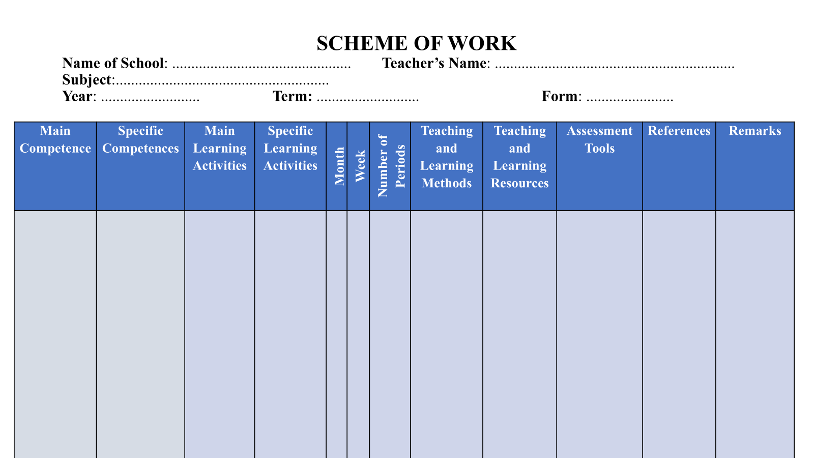
Attachment No. 1: Matrix of the Scheme of work

Slide 7
Scheme of Work
However, All components are taken directly from the syllabus except the specific learning activity, month, week, references, and remarks.
The references are written following APA style version 7.
Author, year of publication, title of the book, publisher

Slide 8
Deconstructing the main learning activity into a specific learning activity
The specific learning activity is obtained by deconstructing the main learning activity taken directly from the syllabus

Slide 9
Writing Remarks for the Scheme of work
In writing the references we normally address three things.
Strength
The activity to describe the periodic table of elements has been facilitated and completed.
2. Weakness
However, a few specific activities were not covered because we were having a guest visit in our school.

Slide 10
Writing Remarks for the Scheme of work
3. Way forward
I expect to use extra time to cover the remaining activities

Slide 11
General characteristics of the specific learning activity
Enable the student to build the intended competence (knowledge, skills and attitude)
Enable the student to use knowledge and skills in other contexts or for other purposes
Enable the student to think creatively and be creative/discoverer in various things
Reflect the real environment of the student/child
Be consistent with the schedule, i.e. time allocated

Slide 12
Questions to consider when preparing specific activities
What activities do you want your students to learn?
Do the activities build/contribute to the main learning activity?
Are the activities constructive? (focus on measurable verbs)
Are the activities arranged in a sequence from easy to difficult?
Are the activities have an indicator of competence building?

Slide 13
Examples of How to develop specific learning activities
Main learning activities
Specific learning activities
Describe the periodic table of elements
Recognise first 20 elements of the periodic table by names along with their symbols
Describe how elements are arranged by atomic number and group similar properties (metals and non metals
Demonstrate how to use periodic table to find atomic mass and number
Compare and contrast properties of metals and non metals
Argue the importance of periodic table in predicting the behaviour of elements during chemical reactions

Slide 14
Note:
In designing specific activities, you should break down the learning activities taken from the syllabus into specific activities.
The criteria to consider include the following:
(a) the specific activity should contribute to the learning activity;
(b) it should focus on the measurable verbs (e.g. identify, explain, define, analyse, etc.); and
(c) the specific activities should be organized from simple to complex

Slide 15
Matrix of the Scheme of work
Activity 01
Choose one main activity from your subject syllabus. Deconstruct it into specific activities

Slide 16
Writing reference
Activity 02
Choose any textbook of your subject and write the reference using a current APA Style.

Slide 17
LESSON PLAN
The revised lesson plan has been designed using the IDDR framework
I stand for Introduction
D stand for Competence Development
D stand for Design
R stand for Realisation

Slide 18
Attachment No.2

Slide 19
COMPONENTS OF THE LESSON PLAN
PRELIMINARY INFORMATION
Teacher’s Name
Subject
School Name
Class
Time
Date

Slide 20
COMPONENTS OF THE LESSON PLAN
B. STUDENT’S INFORMATION
These informations are as seen in Attachment No. 03
Attachment No. 03
Number of Students
Registered |  |  | Present
Boys | Girls | Total | Boys | Girls | Total

Slide 21
Components of the Lesson plan cont...
C. Competence Information
Main Competence
Specific Competence
Main activity
Specific activities
Teaching and Learning Resources
References

Slide 22
Components of the Lesson plan cont...
D. TEACHING AND LEARNING PROCESS
These components result from four letters of IDDR modal as shown in Attachment No. 04
Stage | Time (Minutes) | Teaching Activities | Learning Activities | Assessment Criteria
Introduction
Compentence Development
Design
Realisation

Slide 23
Components of the Lesson plan cont...
E. REMARKS
Use the information obtained from the assessment criteria to remark the performance of the specific activity.

Slide 24
Lesson Plan
In all stages of lesson preparation, at least three main things should be observed: -
Methods;
Activities;
Assessment; and
Teaching and learning resources

Slide 25
Introduction
Activities in this stage engages a learner into learning.
The purpose of this stage is to get the learner’s prior knowledge based on the lesson to be taught.
Use questions or activities that arouse the child’s interest, generate curiosity, and get them involved in the lesson.

Slide 26
Introduction
Provide activities that relate to the new knowledge and skills that the child is expected to develop.
Integrate assessment to identify any misconceptions, what students know, do not know and needs in learning the intended competence
Use the assessment evidences obtained in developing competence in a second stage

Slide 27
Introduction
Example of how to fill this step:
Using periodic table chart, engage the students using the song to identify the elements, names and symbols.
Repeat the song and listen to students carefully

Slide 28
Competence Development
This stage has a great relationship with the introduction stage.
Provide with activities that enable learner to develop understanding/competence (i.e., reading texts, watching videos, listening to audio sources, conducting discussions, investigating, observing, questioning, communicating with peers, interviewing, and the like.

Slide 29
Competence Development
Let them work together to promote sharing and communication among themselves, and give them opportunity to present and clarify what they have learnt.
Continue to assess students’ progress in learning and use the evidences to support them in learning
As, you engage them, they get chance to explore and explain new things in learning processes

Slide 30
Competence Development
Example of how to fill this step:
Using periodic table chart assist students through group discussions to determine the atomic mass and atomic number of elements.
Guide students to present their work and make clarification where necessary.

Slide 31
Design
This stage deepens learning
Allow a learner to apply the knowledge leant in other contexts.
Use activities that guide the learner through performing activities aimed at applying their understandings (the acquired knowledge and skills) to address challenges they face in real-life situation
As students engage in the activities, they get chance to elaborate their learning in depth.

Slide 32
Design
Example of how to fill this step:
Assist students through group discussions to draw the periodic table chart with the 20 elements.
Guide students to present their work and make clarification where necessary.

Slide 33
Realisation
This stage allow assessment and evaluation of students’ achievement.
Design activities that provides opportunities for the teacher to assess learning achievement and students to assess themselves

Slide 34
Realisation
Use different forms of assessment, such as portfolios, performance assessments, interviews, preparation of physical models, quizzes, and many others. This will allow students also to self-assessment and peer assessment
Use assessment evidences as feedback to improve learning if it is required.

Slide 35
Assessment Criteria
Criterion should show clearly the expected performance from a pupil in doing the activities during teaching and learning process.
Criterion of assessment has to focus on specific task given on regards to learning intents.

Slide 36
Assessment Criteria
Example of how to state an assessment criterion, “A picture of a cat is drawn.
A criterion for assessment should be prepared before entering the classroom.

Slide 37
Remarks
Remarks should be reflective comments and observations based on performance of the specific activity.
Therefore, a teacher is expected to do the following at this stage:
Explain the strength or weakness on performing the specific learning activity.
Note areas where students excelled and areas where they may need further support or clarification or consider what went well and what could be improved upon for future lessons.
Use the information obtained from the assessment criteria to remark the performance of the specific activity.

Slide 38
Conclusion
TIE expects that through this approach, students are expected to effectively develop their knowledge, skills, and attitudes that enable them to acquire the necessary skills for the 21st century which will enable them to manage their lives in different ways.

Slide 39
5Es Model

